Slide 1
Smart Cities: Toronto & Portland
Kennedy Hahn, Long Nguyen, Will Regan

Slide 2
Overview
Sidewalk Toronto and data
Portland and data
Permaculture: Framework for sustainable cities

Slide 3
What have we learned since then?

Slide 4
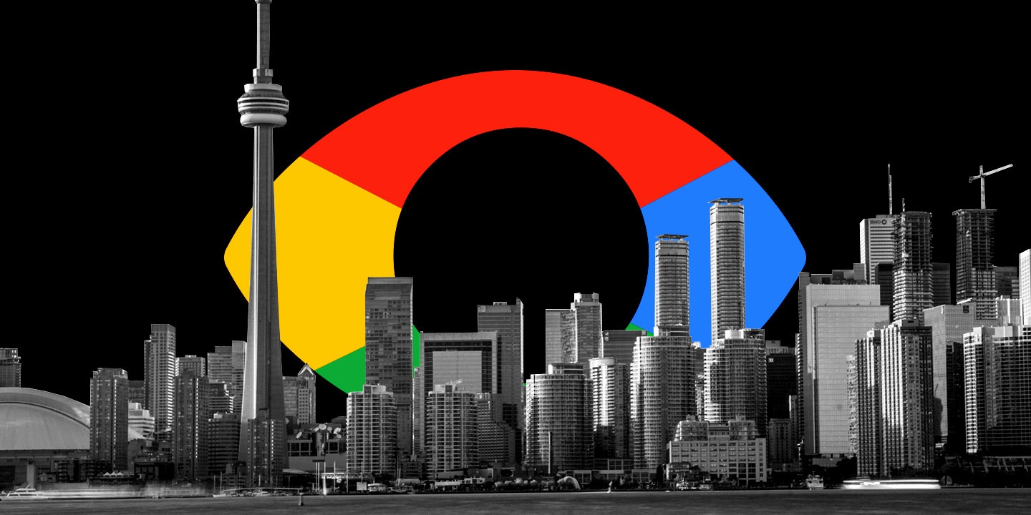
What we have learned - Toronto and Data Privacy
Data collection in the city
Worry that Google will use the personal data for commercial or monetary use, or make it available to third parties

Slide 5
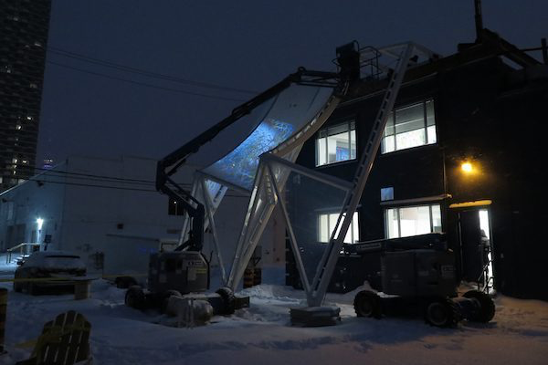
What we have learned - Toronto and Data Privacy
Distraction?

Slide 6
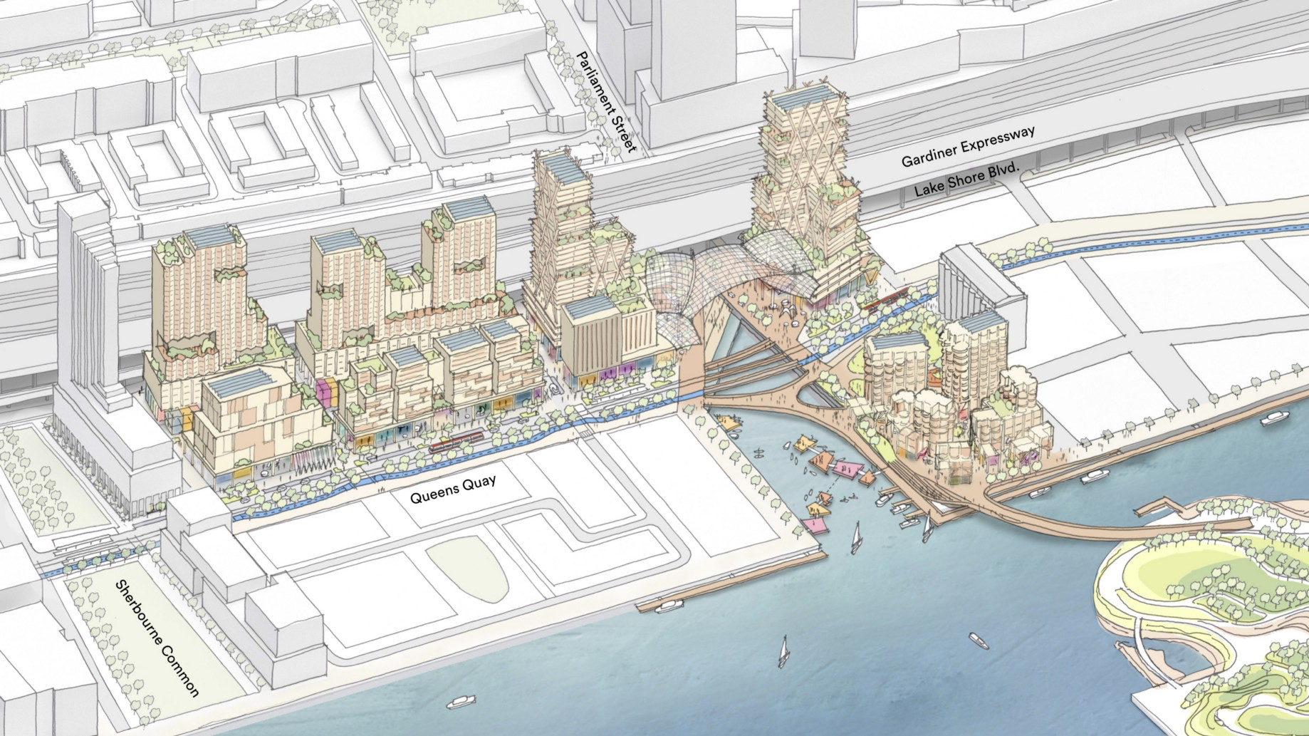
What we have learned - Toronto and Data Privacy
Civic Data Trust

Slide 7
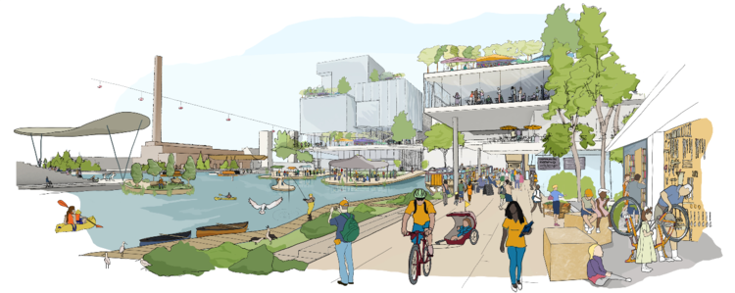
What we have learned - Toronto and Data Privacy
Waterfront Toronto will shut down Sidewalk Toronto project if Sidewalk Labs cannot find proper solutions to their issues (including data privacy) by October

Slide 8
What we have learned - Portland
Robust privacy and information protection are cornerstones for building trust across organizations and people. Building this trust is at the center of the City of Portland Privacy and Information Protection Principles.
The City of Portland collects and manages data that may put communities, individuals or sensitive assets at risk

Slide 9
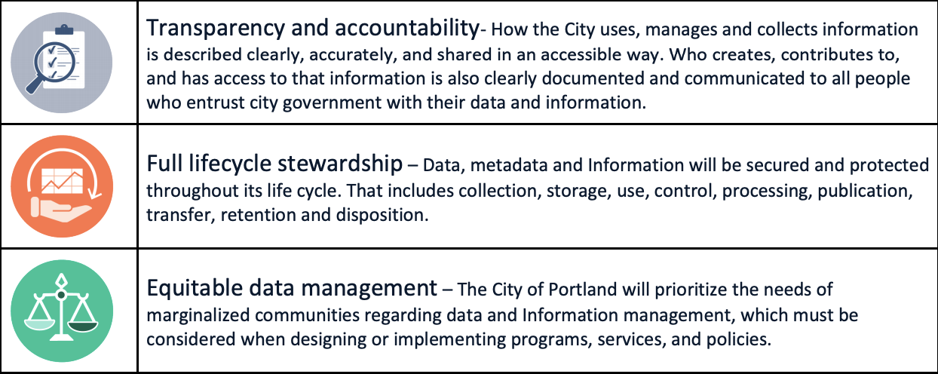
Portland - Privacy Principles

Slide 10
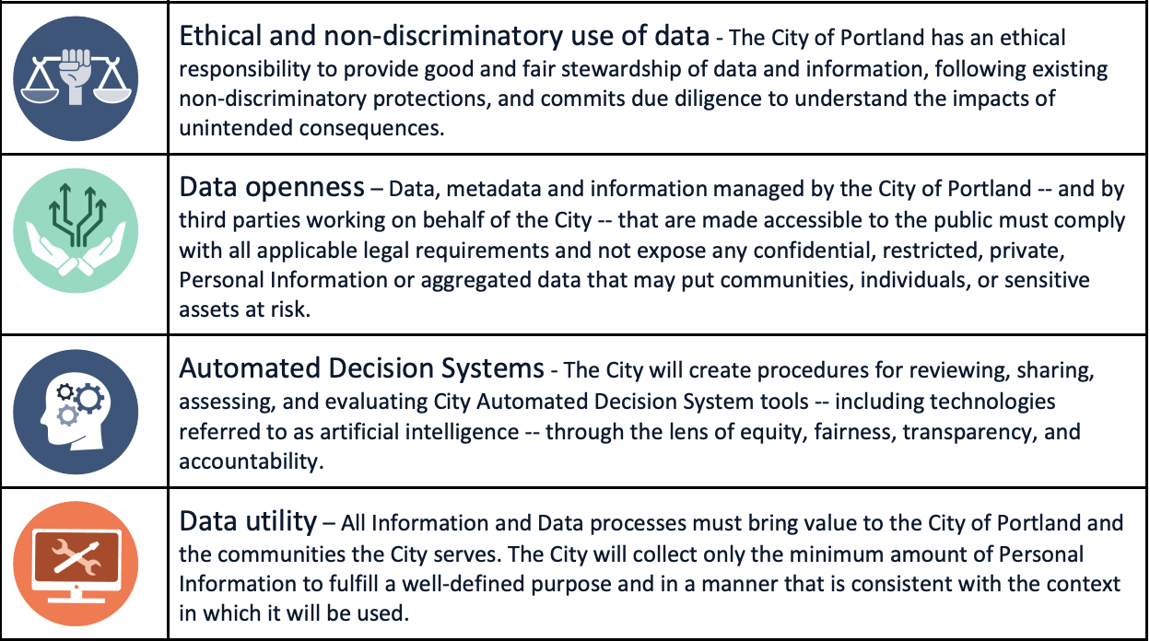
Portland - Privacy Principles

Slide 11
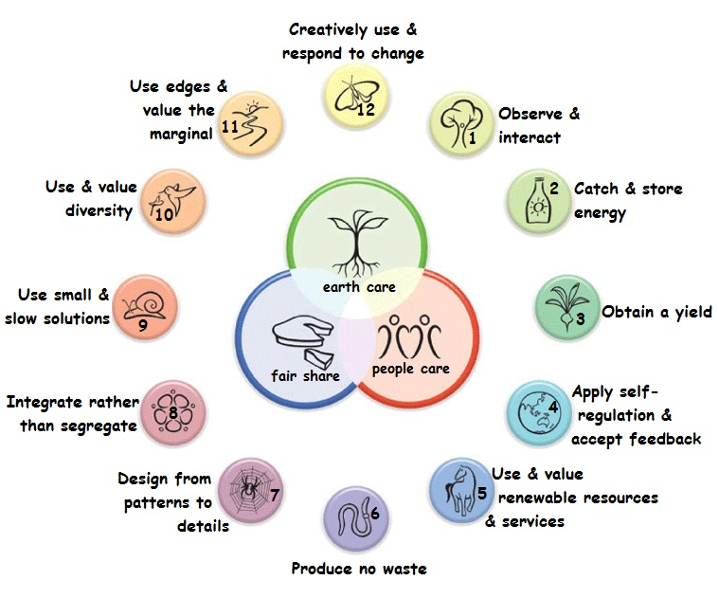
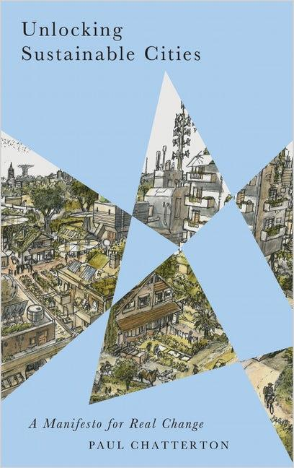

Permaculture:
A means to more sustainable cities

Slide 12
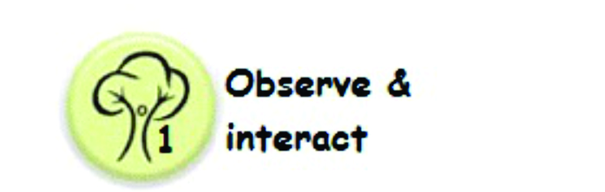
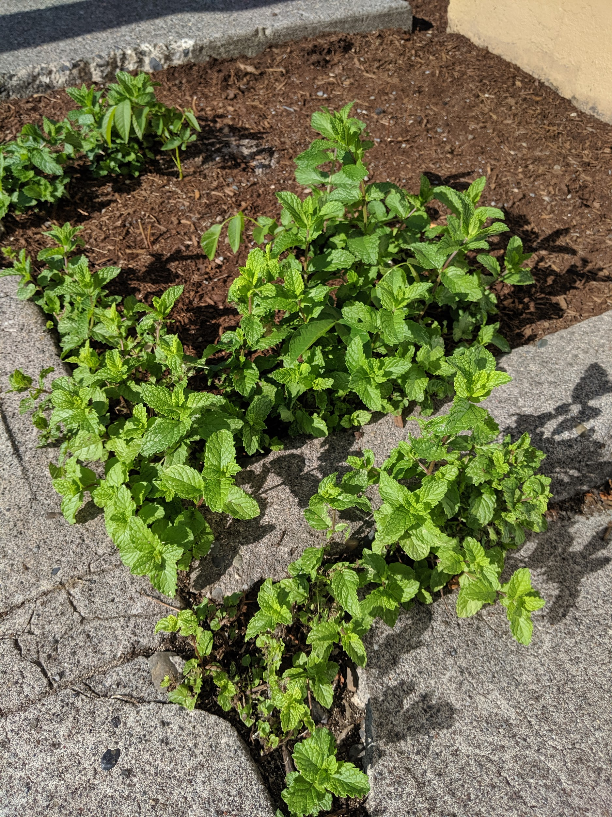
Live in the moment and see and feel all things around you. Interact in your community.

Slide 13
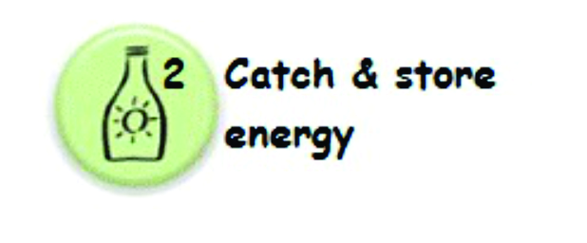
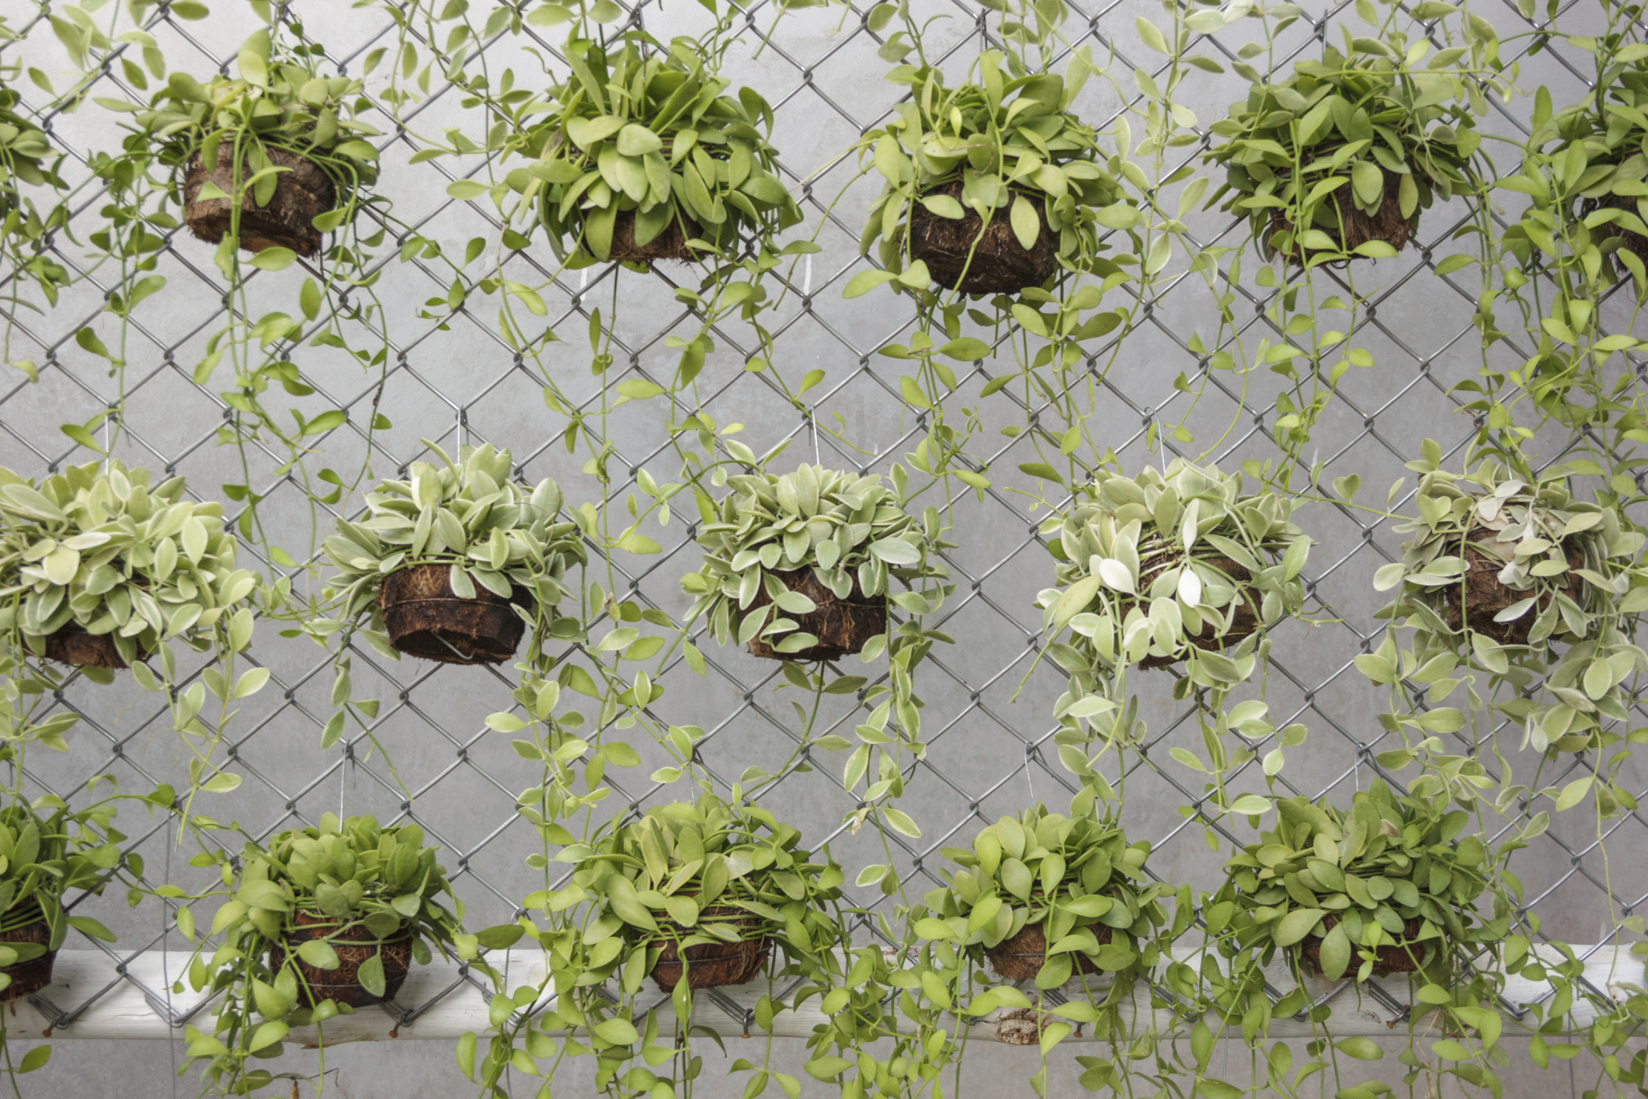
Carbon is energy, data is energy. Don’t take any kind of energy for granted, because it’s what gives life and allows us to thrive.
https://www.harryhelmet.com/lets-get-vertical-a-primer-on-vertical-gardening/

Slide 14
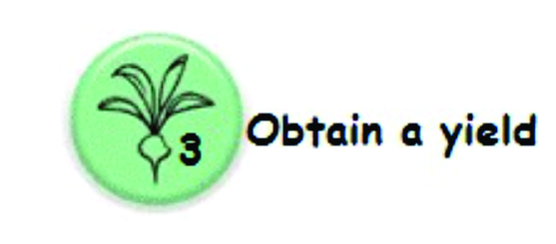
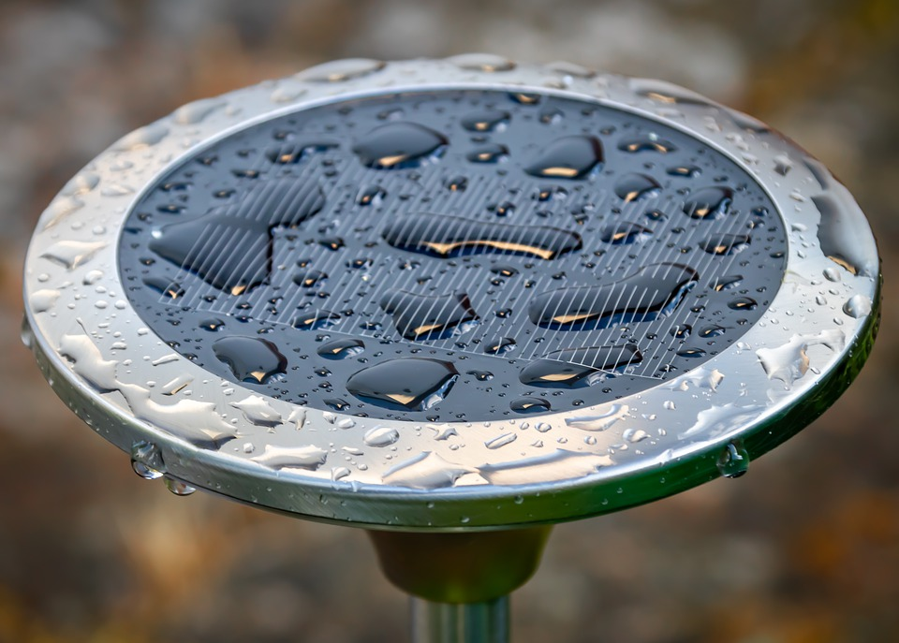
Whether it be setting up your own solar panels, garden, or capturing rainwater to irrigate your plants. The sun, rain and wind are naturally occurring elements which can provide bountiful yields.

Slide 15
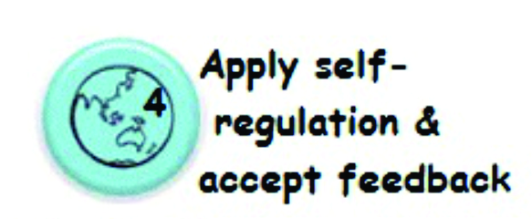

Pay attention to what works best, and focus on that. It may be you are better with solar panels than gardening. Use that.

Slide 16
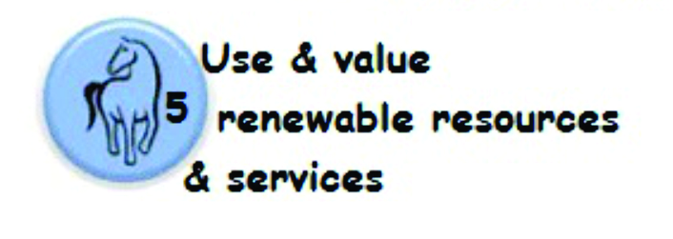
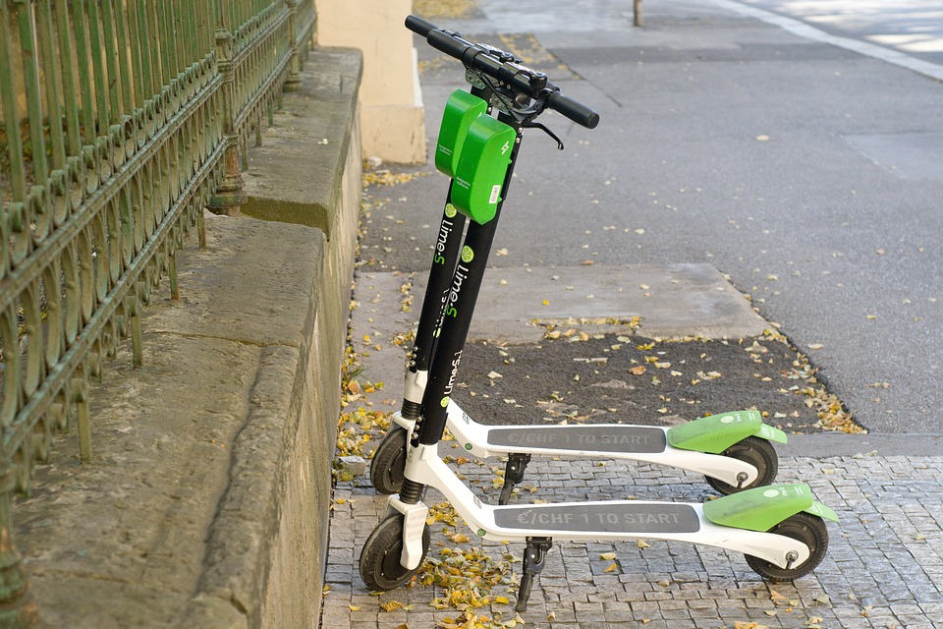
Try out the electric scooters, and all forms of transportation. Avoid the non-renewables, such as plastic bottles, or packaged fruits.

Slide 17
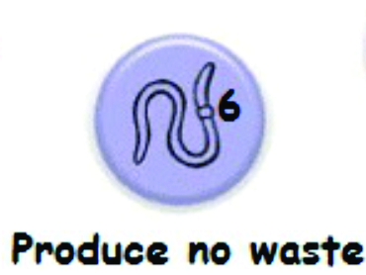
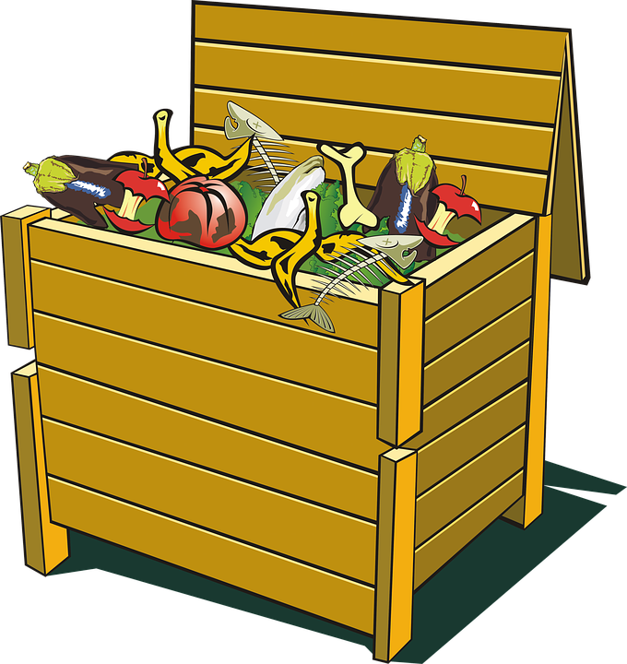
Try composting your own garbage

Slide 18
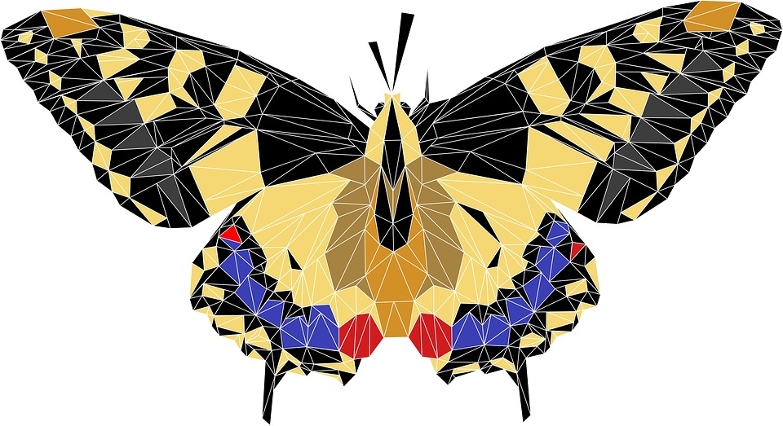
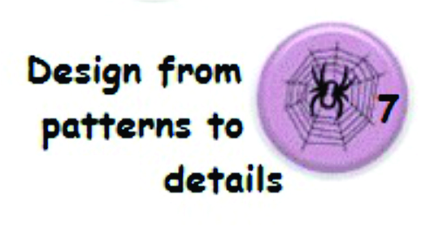
Plan trips carefully

Slide 19
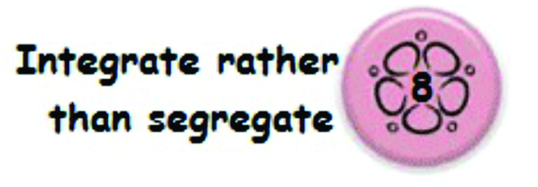

Allow the elements of your environment to support each other. Can you combine your office as a second bedroom and set up an Airbnb for the weekends?

Slide 20
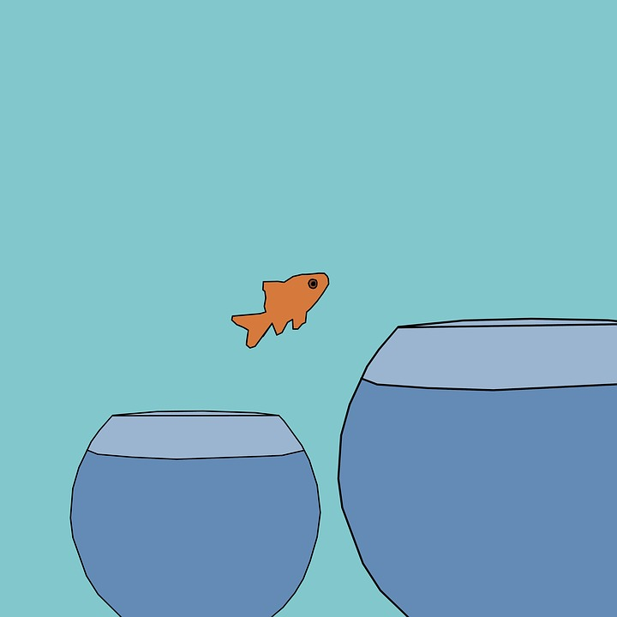
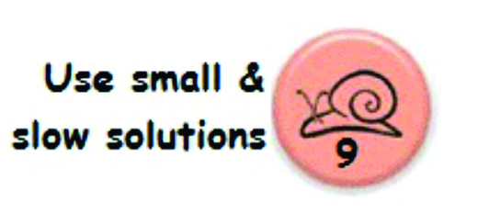
Careful with big solutions.

Slide 21
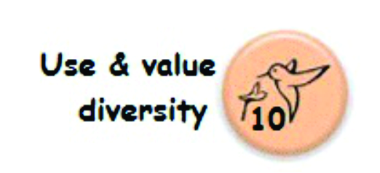
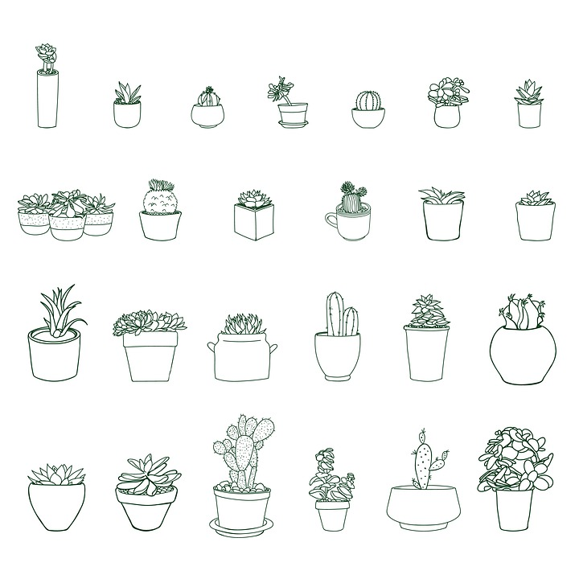

Slide 22


Pay attention to what’s on the cutting edge, that may be overlooked.

Slide 23
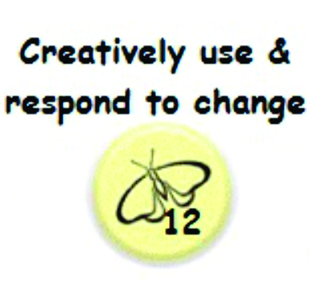


Slide 25
Thank you!

